Slide 1
WEBSITE DESIGN WITH HUGO AND ACADEMIC
Jeanet Mante
and Pedro Fontanarrosa

Slide 2
Overview
Introduction to website design
Hugo and Academic
File Organisation
Potential COMBINE implementation
Getting Started

Slide 3
Introduction to Website Design

Slide 4
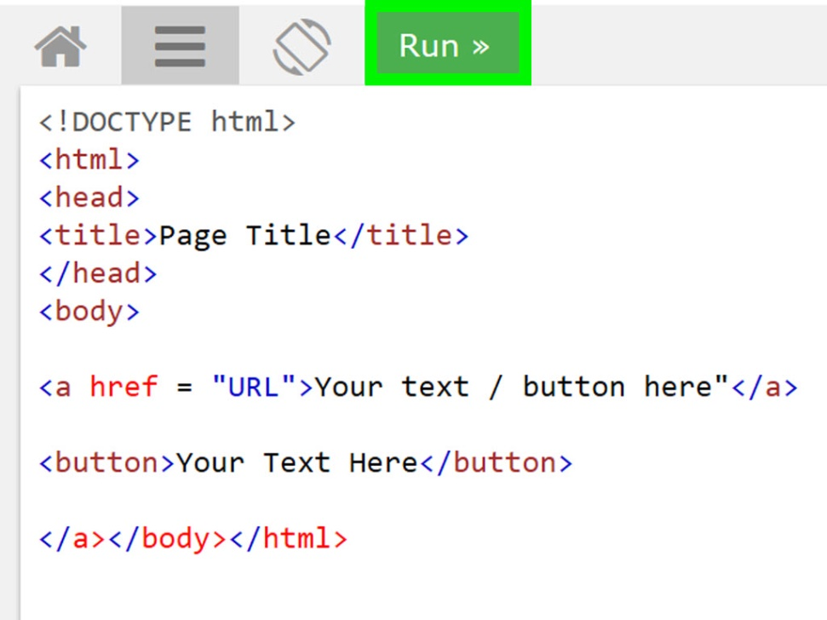
Basic Web Design
A static html or markup website is displayed at a URL
Can be made more interactive using javascript

Slide 5
Hugo and Academic

Slide 6

Hugo takes data files, i18n bundles, configuration, templates for layouts, static files, and content written in Markdown or Org-mode and renders a static website.
Written in GO
Features:
Multilingual support
Custom output formats
Nested sections

Slide 7

Hugo Theme
The Hugo Academic Resumé Template empowers you to create your job-winning online resumé and showcase your academic publications
Note there are other templates

Slide 8
Widgets
Formatting Plugins
Automate pulling of information

Slide 9
File Organisation

Slide 10
File Layout
Config\_default
Menus.toml (top menu)
Params.toml (contact information)
Content
Authors
File for each other (must be first-last)
_index.md
Avatar.jpg or avatar.png
Every Menu Page
Index.md
.md file for every widget
Layouts
Authors
Partials
Widgets

Slide 11
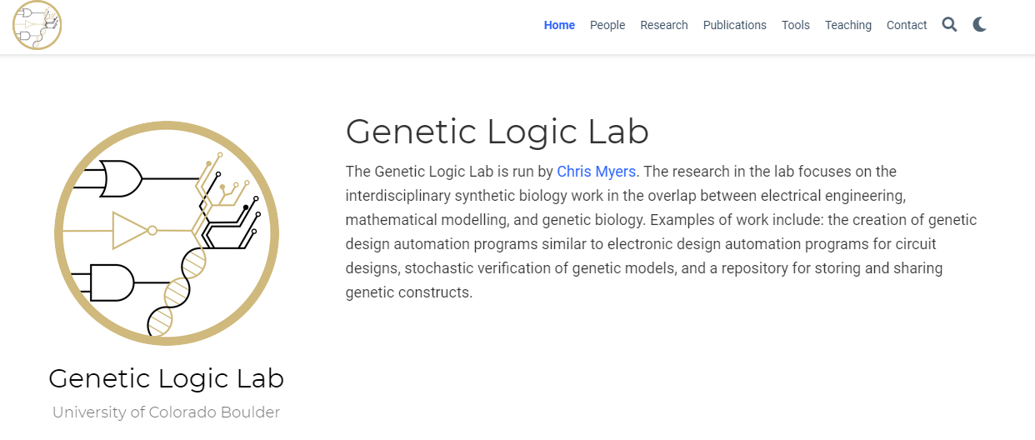
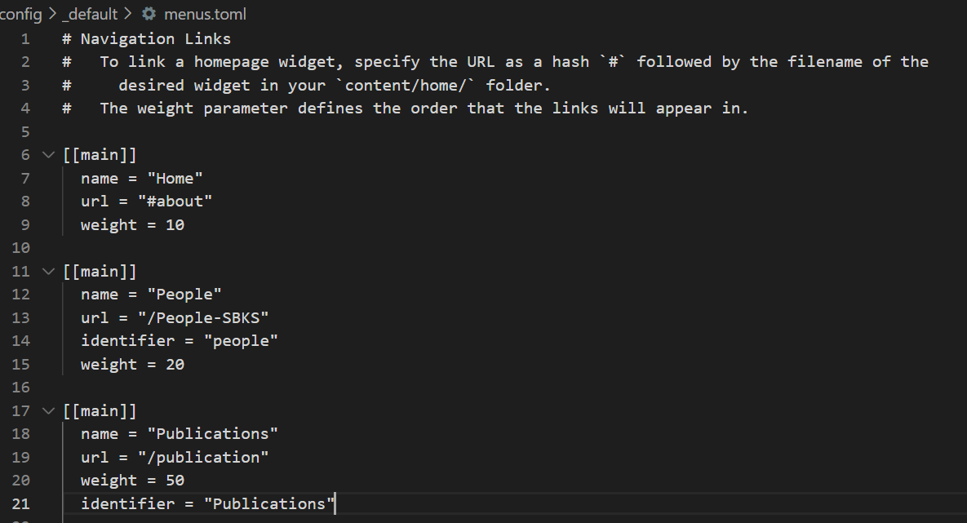
Config: Menus.toml

Slide 12
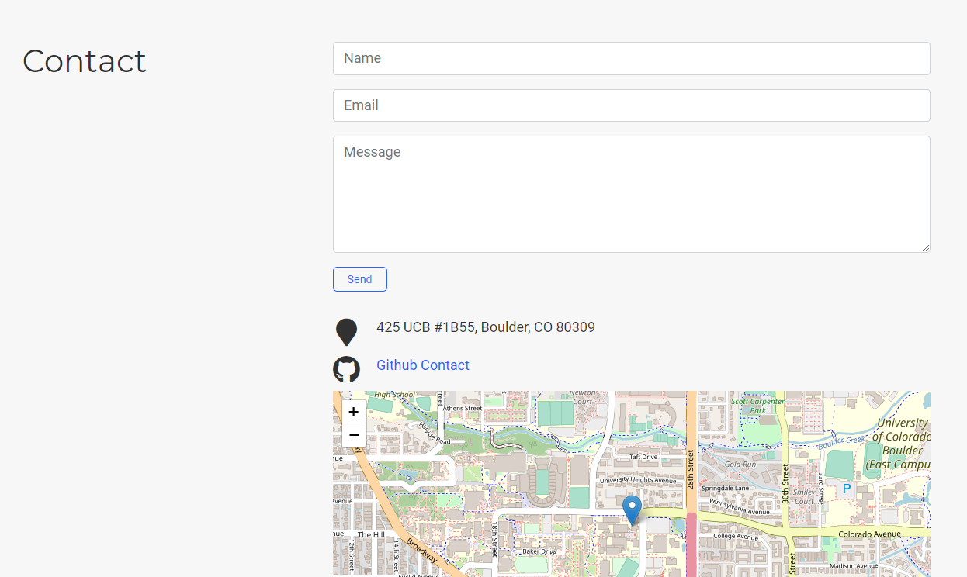
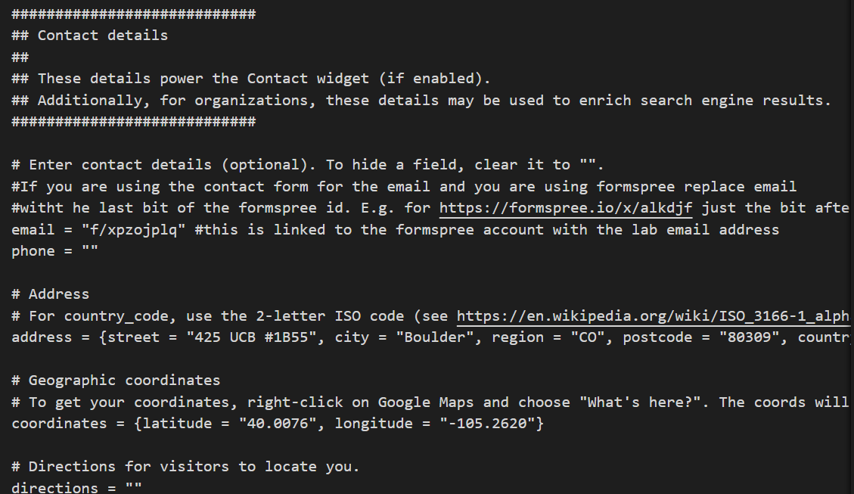
Config: Params.TOML

Slide 13
File Layout
Config\_default
Menus.toml (top menu)
Params.toml (contact information)
Content
Authors
File for each other (must be first-last)
_index.md
Avatar.jpg or avatar.png
Every Menu Page
Index.md
.md file for every widget
Layouts
Authors
Partials
Widgets

Slide 14
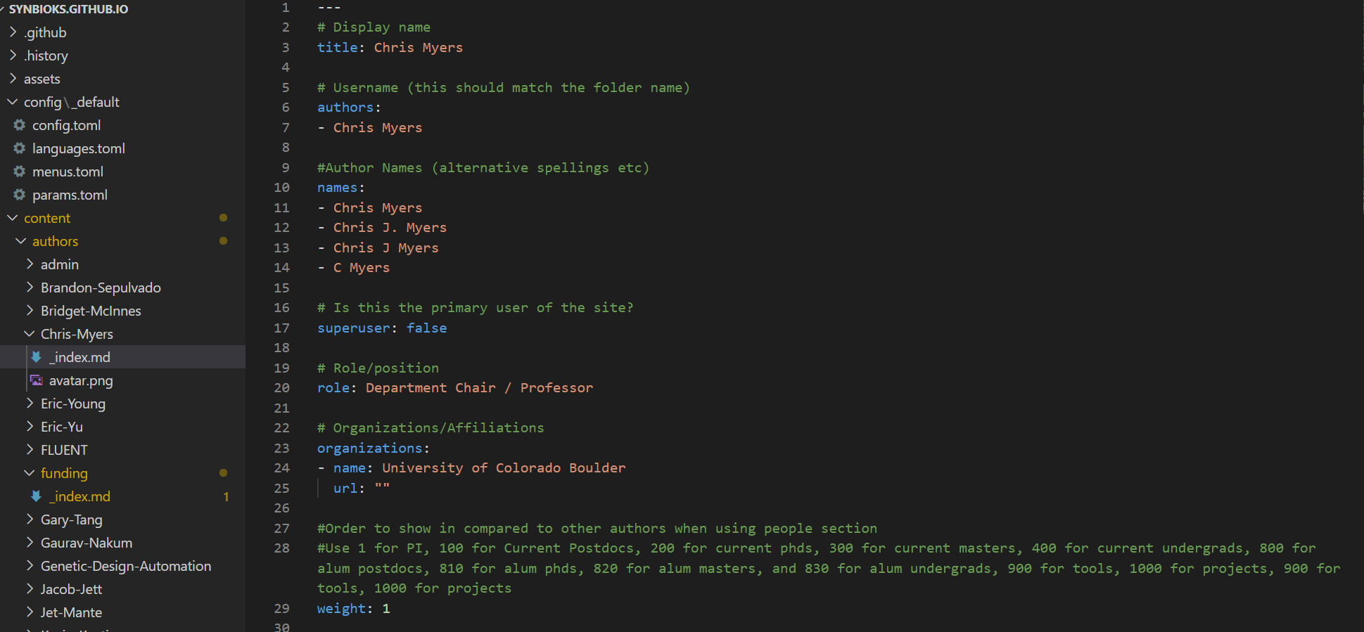
Content: Authors

Slide 15
Content: Authors

Slide 16

Content: Authors

Slide 17

Content: Authors

Slide 18
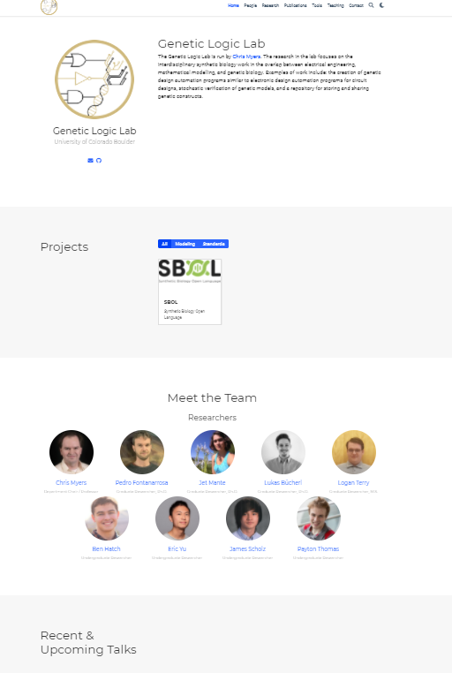
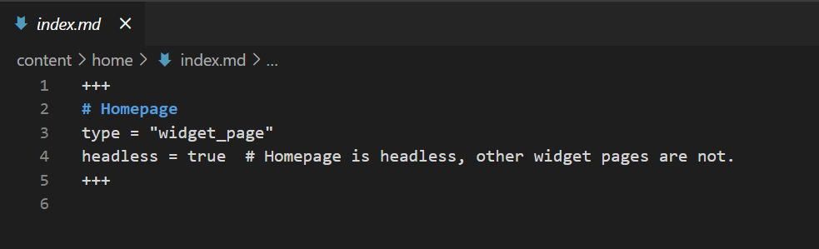
Content:Home

Slide 19
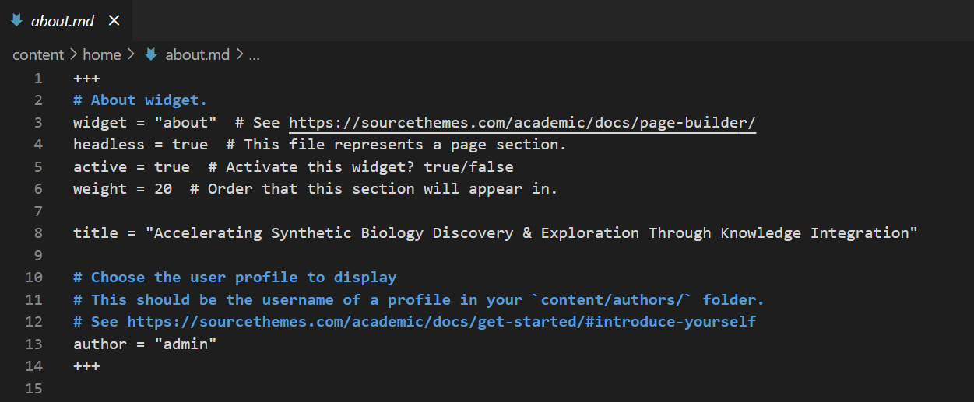
Content:Home

Slide 20
Content:Home

Slide 21
File Layout
Config\_default
Menus.toml (top menu)
Params.toml (contact information)
Content
Authors
File for each other (must be first-last)
_index.md
Avatar.jpg or avatar.png
Every Menu Page
Index.md
.md file for every widget
Layouts
Authors
Partials
Widgets

Slide 22
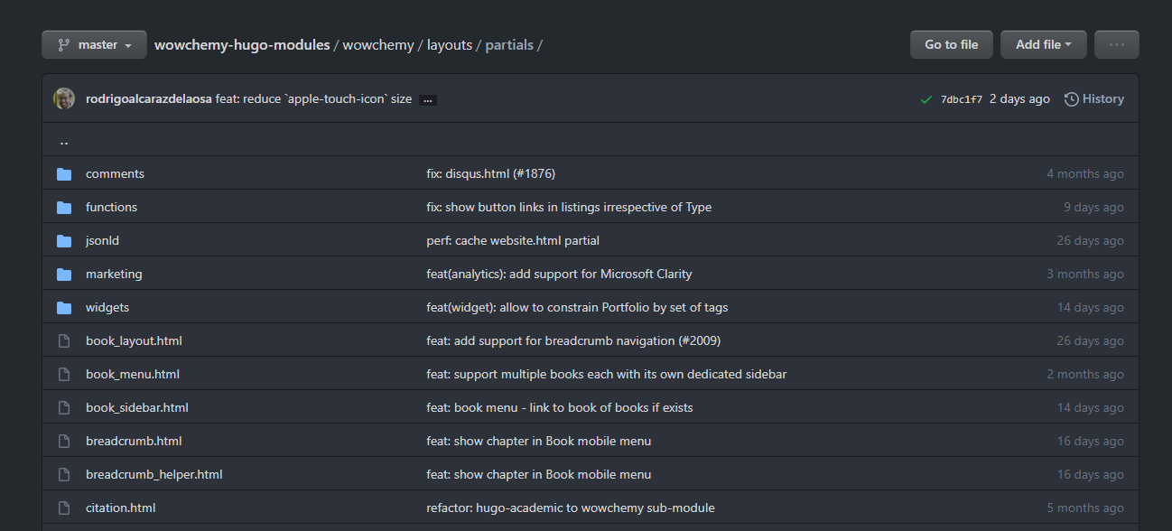
Layouts
https://github.com/wowchemy/wowchemy-hugo-modules/tree/master/wowchemy/layouts

Slide 23
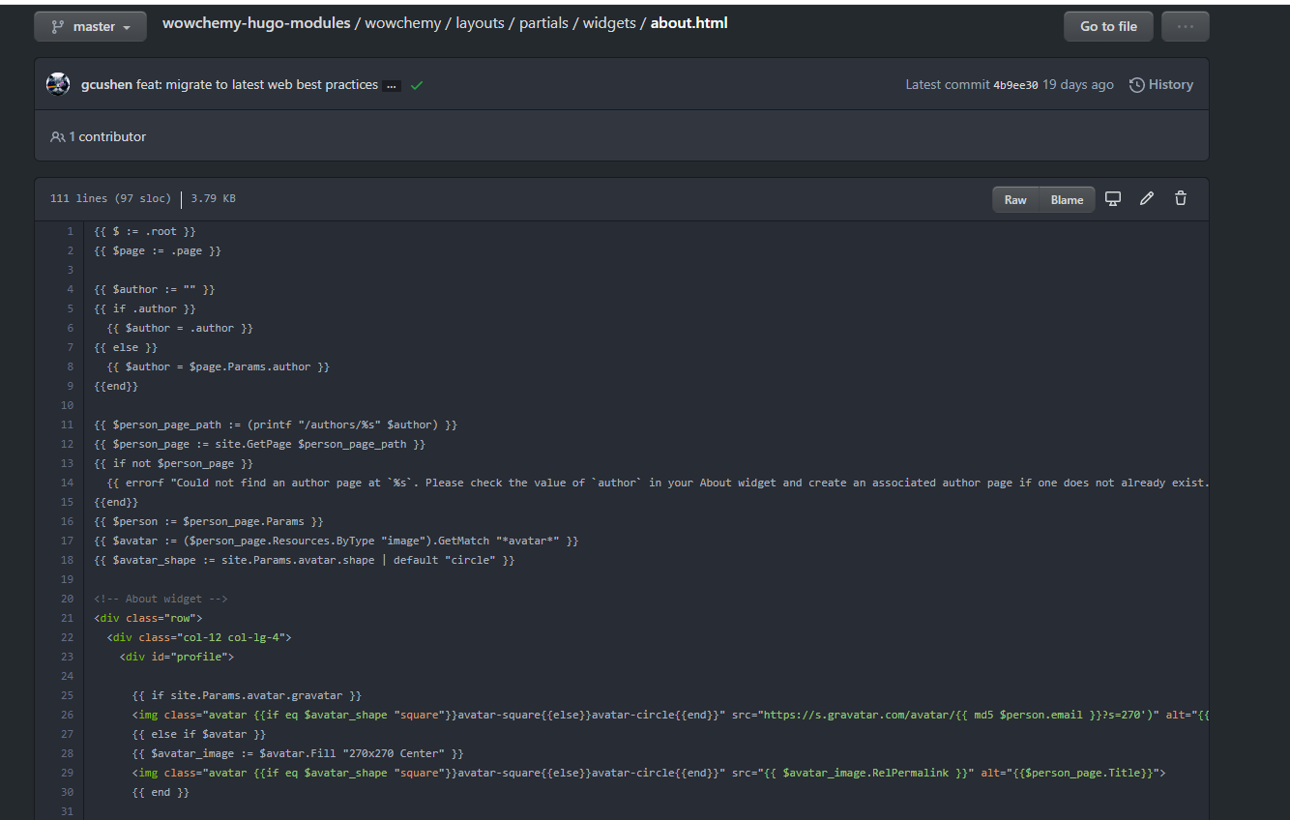
About WIdget

Slide 24
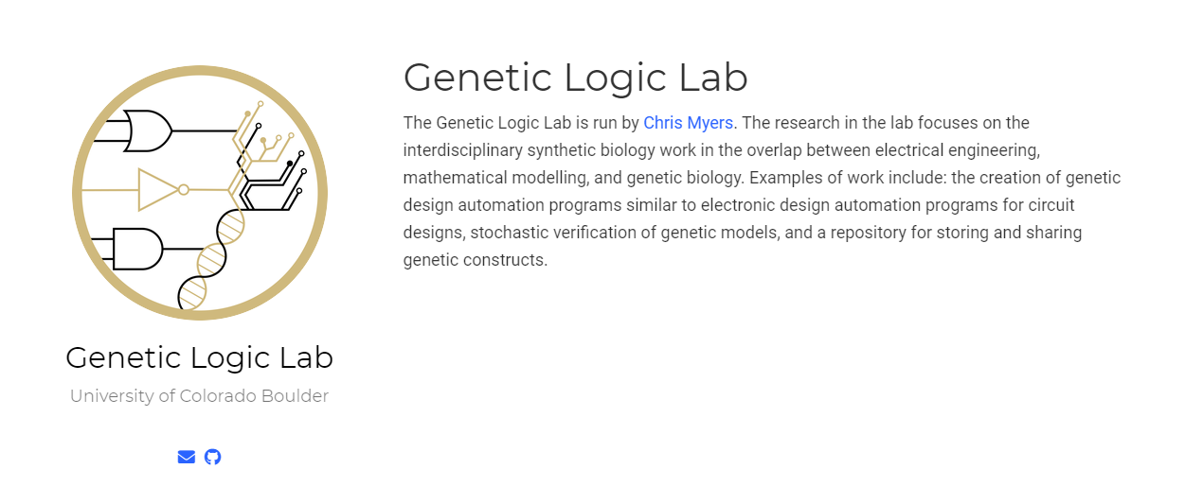
About WIdget

Slide 25
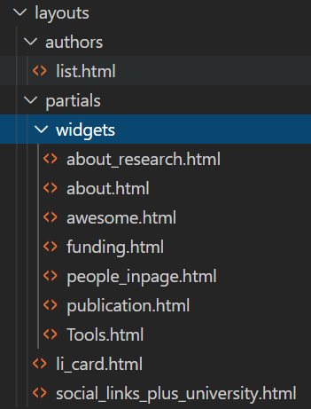
Custom Widgets and Layouts
Overwrite standard widgets and partials by putting a file of the same name in the same place

Slide 26
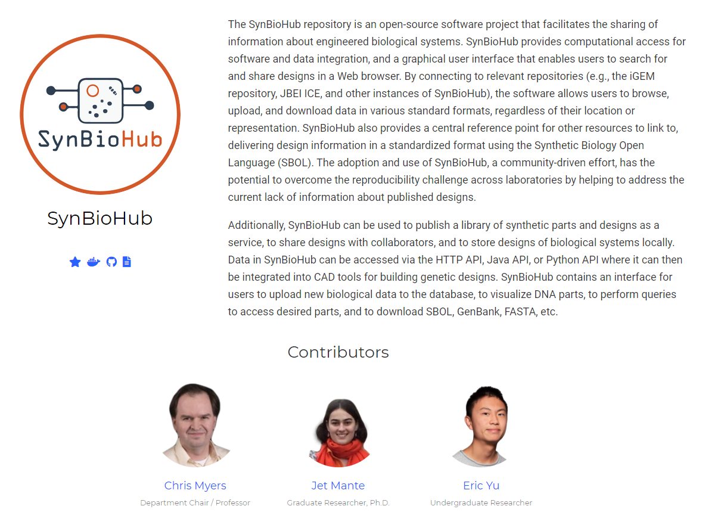
Custom Contributors Widget

Slide 27

Custom Contributors Widget Based on People

Slide 28
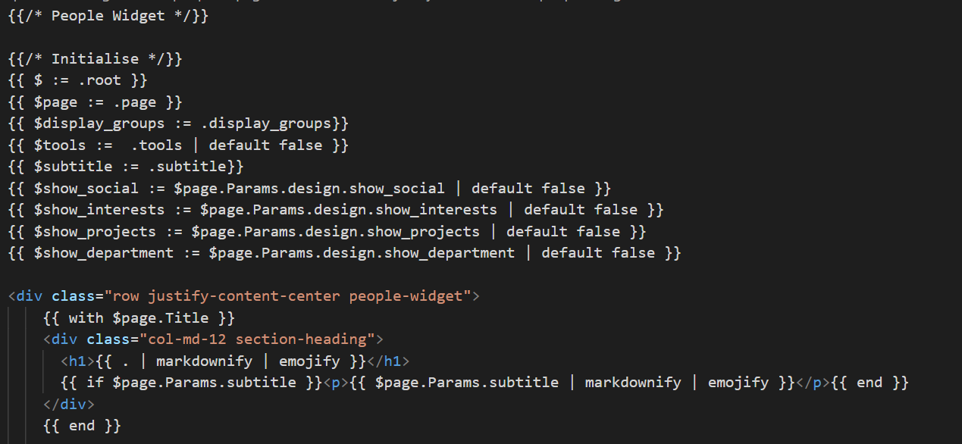
GOLANG

Slide 29
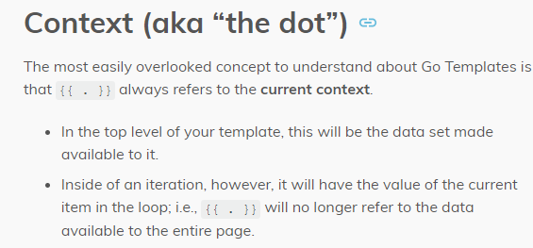
Go
Introduction to templates: https://gohugo.io/templates/introduction/
Functions overview: https://gohugo.io/functions/

Slide 30
Potential COMBINE Implementation

Slide 31
Potential Organisation
Menus
Home
About text and logo (About widget)
Co-ordination (people widget)
Current Event
Contact
Standards
Standards (about widget for each)
Associated efforts and Related efforts (People widget with sub headings)
Events
Current event (about widget)
Past events (people widget)
NB: for the associated author page with more info it will require a special widget pages for events
Documents
List of documents
Contact (links back to home page widget)

Slide 32
Example
https://combine-org.github.io/#about

Slide 33
Getting Started

Slide 34
Installation
Install Hugo (https://gohugo.io/getting-started/quick-start/)
Open terminal and cd to an appropriate file location
Git clone the project folder (https://github.com/combine-org/combine-org.github.io)
Cd to folder you just cloned
Run `hugo server`
Check the server is up and running at localhost:1313
Suggest editing the file structure using VS code

Slide 35
Resources
Example sites:
Genetic Logic Lab: https://geneticlogiclab.org/#about
Github: https://github.com/MyersResearchGroup/myersresearchgroup.github.io
SBKS: https://synbioks.github.io/
Github: https://github.com/synbioks/synbioks.github.io
SBOL Standard: https://sbolstandard.org/
https://github.com/SynBioDex/SbolStandardWebsite
Partials and widgets layout: https://github.com/wowchemy/wowchemy-hugo-modules/tree/master/wowchemy/layouts
Templates documentation: https://gohugo.io/templates/introduction/
Functions documentation: https://gohugo.io/functions/
Academic documentation: https://wowchemy.com/docs/
Hugo Documentation: https://gohugo.io/documentation/
Install Hugo: https://gohugo.io/getting-started/quick-start/
Current COMBINE Website: http://co.mbine.org/home
COMBINE Github Repo: https://github.com/combine-org/combine-org.github.io
COMBINE Page: https://combine-org.github.io/#about

